Slide 1
DSP(Digital Signal Processing) Program
(해당 강의자료의 배포 및 무단 복제를 금함)
http://dms.sejong.ac.kr
http://home.sejong.ac.kr/~yllee/
Prof. Yung-Lyul Lee (이영렬 교수)

Slide 2
Program Exercises
2D Discrete Fourier Transform(DFT) & Inverse DFT
Subsampling( Zoom-out ) -> 256x256 (input image)
이유는 무식하게 program을 짜기 때문에 많은 시간 소요
Fast algorithm (FFT) 강의예정
집현시스템에 experiments.zip 파일로 제출
실습 1의 결과와 함께
Source code DFT-IDFT를 1개의 code로 작성, code-DFT-IDFT.c
DFT의 magnitude (bitmap), output_DFT-magnitude.bmp,
Magnitude 만으로 inverse DFT 하면 안됨. (phase가 없기 때문에)
inverse DFT 영상 (bitmap), output_inverseDFT.bmp

Slide 3
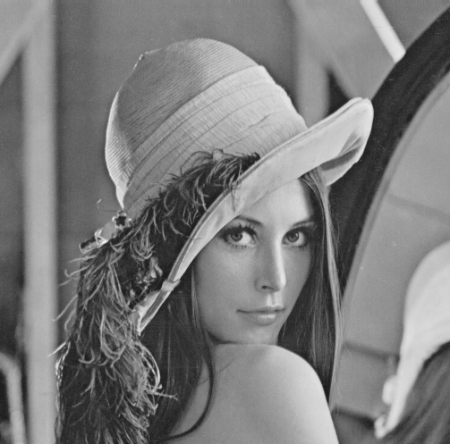
실습이미지 - lena.img
512
512 x 512 (pixel by pixel size)
밝기 값만 가지고 있는 이미지
8 bits range
512

Slide 4

# DFT 하기 전 - Lana 이미지 축소(256x256)
512
256
256
512
DFT 실습 영상
Lena.img (256x256)

Slide 5
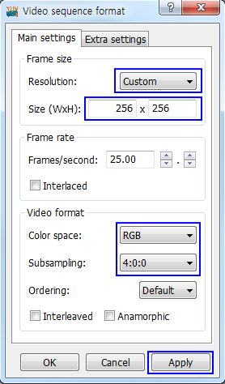
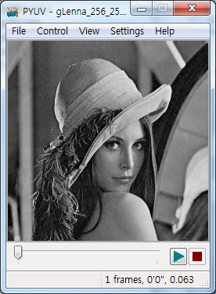
pYUV로 bitmap file 생성가능
다운로드 경로
http://dsplab.diei.unipg.it/~baruffa/dvbt/binaries/player/win32/

Slide 6



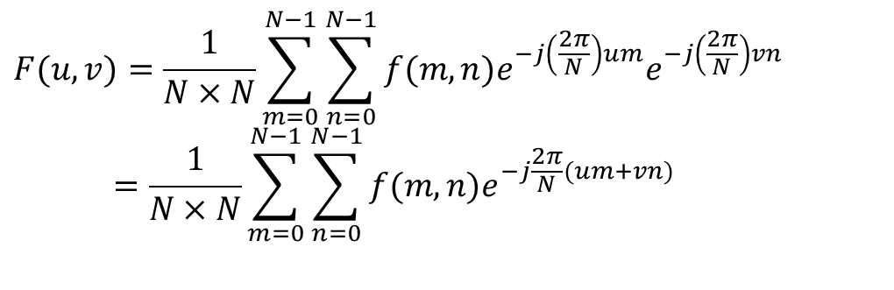
1. 2D Discrete Fourier Transform & IDFT
DFT 2D
Inverse DFT
$$F(u,v)=\frac{1}{N×N}\sum_{m=0}^{N−1}{\sum_{n=0}^{N−1}{f(m,n)e^{−j\left(\frac{2π}{N}\right)um}e^{−j\left(\frac{2π}{N}\right)vn}}} \\ =\frac{1}{N×N}\sum_{m=0}^{N−1}{\sum_{n=0}^{N−1}{f(m,n)e^{−j\frac{2π}{N}(um+vn)}}}$$
$$F\left(u\right)=\frac{1}{N}\sum_{m=0}^{N−1}{f(m)e^{−j\frac{2π}{N}um}}$$
$$F\left(u−u_{0}\right)=\frac{1}{N}\sum_{m=0}^{N−1}{f(m)e^{−j\frac{2π}{N}(u{−u}_{0})m}}$$
$$F\left(u−N/2\right)=\frac{1}{N}\sum_{m=0}^{N−1}{f(m)e^{−j\frac{2π}{N}(u−N/2)m}}$$
$$=\frac{1}{N}\sum_{m=0}^{N−1}{{(−1)}^{m}f(m)e^{−j\frac{2π}{N}um}}$$
$$f(m,n)=\sum_{u=0}^{N−1}{\sum_{v=0}^{N−1}{F(u,v)e^{j\left(\frac{2π}{N}\right)um}e^{j\left(\frac{2π}{N}\right)vn}}} \\ =\sum_{u=0}^{N−1}{\sum_{v=0}^{N−1}{F(u,v)e^{j\frac{2π}{N}(um+vn)}}}$$

Slide 7
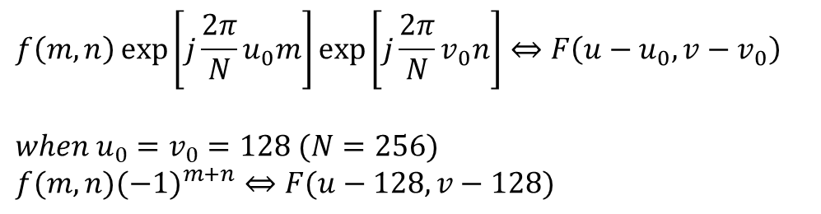
Basic steps for filtering
in frequency domain
• Follow the following procedures:
1. Multiply input image by (-1)^{m+n} to center the transform
2. Compute F(u, v), the DFT of the image from the previous step
(3. Multiply F(u, v) by a filter function H(u, v) studied in Image Enhancement)
4. Compute inverse DFT of the result
5. Obtain the real part of the result in the step 4.
6. Multiply the result by (-1)^{m+n}
using:
$$f\left(m,n\right)\exp\left[j\frac{2π}{N}u_{0}m\right]\exp\left[j\frac{2π}{N}v_{0}n\right]⇔F\left(u−u_{0},v−v_{0}\right)$$
$$when u_{0}=v_{0}=128 (N=256) \\ f(m,n)(−1)^{m+n}⇔F(u−128,v−128)$$
Shift in Frequency domain

Slide 8
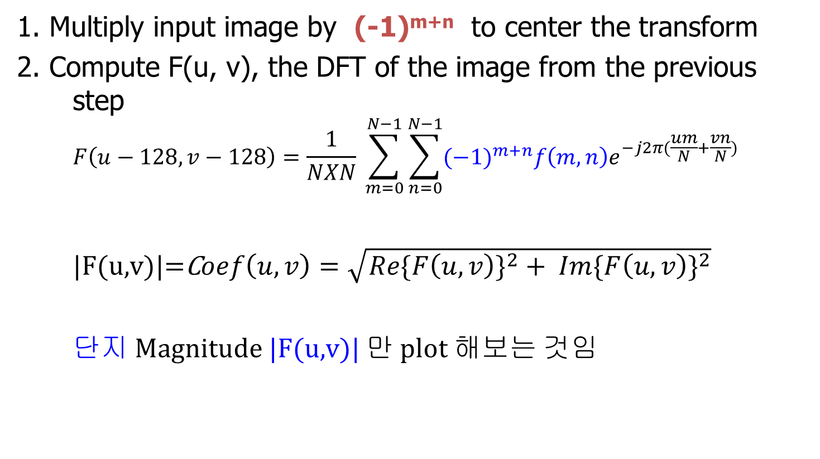
2D Discrete Fourier Transform (M,N=256)
1. Multiply input image by (-1)^{m+n} to center the transform
2. Compute F(u, v), the DFT of the image from the previous step
$$F\left(u−128,v−128\right)=\frac{1}{NXN} \sum_{m=0}^{N−1}{\sum_{n=0}^{N−1}{{(−1)}^{m+n}f\left(m,n\right)e^{−j2π(\frac{um}{N}+\frac{vn}{N})}}}$$
|F(u,v)|=C$oef\left(u,v\right)=\sqrt{{Re\{F\left(u,v\right)\}}^{2}+ {Im\{F\left(u,v\right)\}}^{2}}$
단지 Magnitude |F(u,v)| 만 plot 해보는 것임

Slide 9
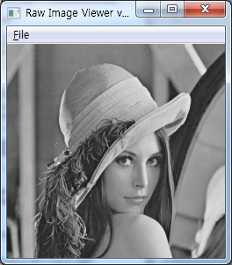
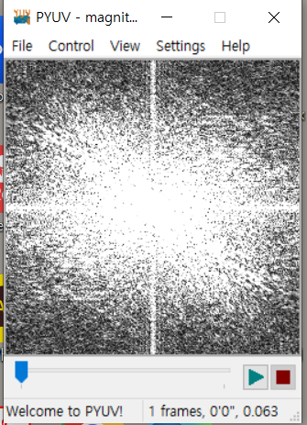
2D Discrete Fourier Transform 결과
DFT
Original
Lena.img
(256x256)
DFT-magnitude.img

Slide 10
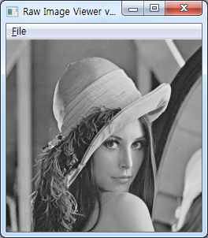
2D Inverse Discrete Fourier Transform 결과
IDFT
Inverse DFT
Out.img

Slide 11
원본 영상과 IDFT영상 비교
Same
Image
Original
Lena.img
(256x256)
Inverse DFT
Out.img

